Slide 1
Day 3 & 5 Predictive Analytics: Introduction and Application
Prof. Prashant Sharma, Fellow (NIFM, Ministry of Finance)
Associate Professor (Finance)
IIHMR University, Jaipur
prashant@iihmr.edu.in

Slide 2
Types of Variables
Dependent
Independent
Control

Slide 3
Regression Analysis (CLRM – BLUE Best Unbiased Linear Estimator)
Originally given by Galton as universal law of regression
Relationship between one dependent variable and explanatory variable(s)
To model the changes in dependent variable with respect to changes in independent variables
Used Mainly for Prediction & Estimation
Regression Equation
Y = α + β* X + ε
Where Y is dependent, and X is independent Variable
α is intercept and β is coefficient
ε is the error term (ε = Y-Ỳ)

Slide 4
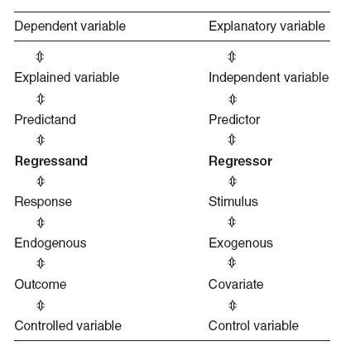
Different Nomenclature for Type of Variables

Slide 5
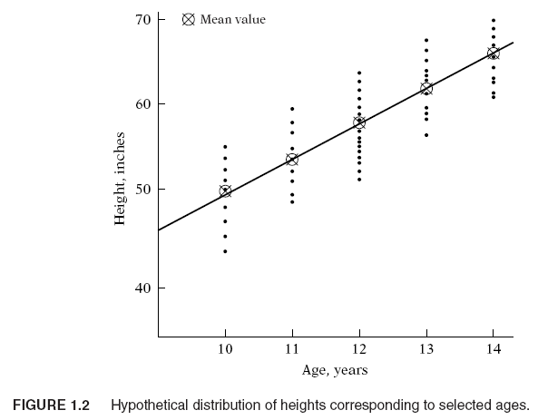
Regression Analysis

Slide 6
Types of Data
Cross-sectional (Data of different variables at one point in time)
Time Series (data collected across time)
Pooled (Mix of cross-sectional and time series)
Panel/ Longitudinal (Mix of cross-sectional and time series in systematic manner)

Slide 7
Levels of Measurement
Nominal
Ordinal
Interval
Ratio

Slide 8
Type of Models
Dependent Variable Type | Independent Variable(s) Type | Type of Model to be used
Continuous | Continuous | Simple Regression/Multiple Regression
Continuous | Categorical | Dummy Variable Regression
Categorical | Continuous | Logistic Regression
Categorical | Categorical | Classification Techniques

Slide 9
Spurious Regression
Adjusted R-Square = 99% (False regression)
Example:
Trader in Stock Market
Every day he used to observe the position of fly in his room (1,2,3,4,5)
Profit/Loss Position in the market
Situation 1: 1-Profit
Situation 2: 2-Loss
Situation 3: 3-Neutral
Situation 4: 4-Neutral
Situation 5: 5-Neutral

Slide 10

Assumptions
Assumption 1:
The regression model is linear in the parameters; it may or may not be linear in the variables.
$Y=α+ β^0 ∗x^{}$ + ε ………………………(1)
$Y=α+ β ∗x^{2}$ + ε ………………………(2)
$$Y=α+ β ∗\frac{1}{x}\text{+ }\text{ε}\text{ ………………………(}\text{3}\text{)}$$
$Y=α+ β^{2}∗X$ + ε ………………………(4)
$Y=α+\frac{1}{β}∗X$ + ε ………………………(5)

Slide 11
Assumptions
Assumption 2:
The regression model used in the analysis is correctly specified, that is, there is no (model) specific error or bias.
Assumption 3:
No multicollinearity among the independent variables.
(When the correlation between/among the independent variables is significant)
Assumption 4:
Given the values of the X variables, the expected, or mean, value of the error term ε is 0.

Slide 12
Multicollinearity Further Explained
You try to model the changes in dependent variable with respect to the changes in the independent variables.
Correlation between
W&C: 0.90
W&E: 0.93
C&E: 0.95
Process
Use car package
vif, the variables with high VIF should be removed.

Slide 13
Assumptions
Assumption 5:
The error variance is homoscedastic OR there is no problem of heteroscedasticity
If error variance is not constant, it is the problem of heteroscedasticity.
If error variance is constant, it will be termed as homoscedastic (Assumption is fulfilled).
Assumption 6:
The error term ε follows the normal distribution with 0 mean and (constant) variance.
Assumption 7:
No autocorrelation or serial correlation.
There is no correlation between error terms belonging to two different observations.

Slide 14
Heteroscedasticity
How to overcome the problem
Transformation of variables (dependent and independent)
First dependent and then independent
Type of Transformations
Log transformation
Inverse
Square
Cube
Etc.

Slide 15
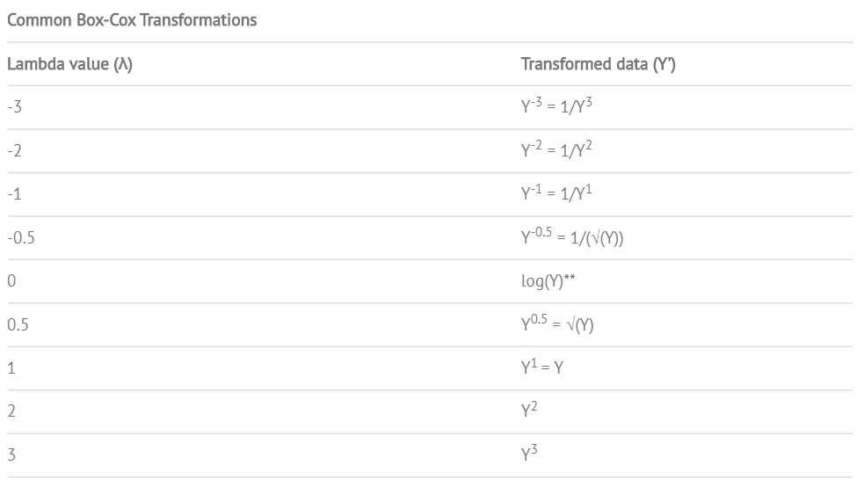
Box-Cox Transformation

Slide 16
Lets Practice!

